Slide 1
Unit 8 - Probability
Experimental and Theoretical Probability

Slide 2
Warm Up
Look for the error in the following problem. Explain and correct the error.
Solve for x
3x – 9 = 18
-9 -9
3x = 9
3x/3 = 9/3
x = 3

Slide 3
Agenda
Warm Up
Announcements
What is Probability?
Theoretical and Experimental Probability
Whiteboard Practice
Independent Practice
Exit Ticket

Slide 4
Announcements
Math starts today!!!
Expect a test sometime next week…do your best now to prepare for the test and get a great start on the semester

Slide 5
What is probability?
The probability of an event happening in a random experiment is the ratio (fraction) of the number of successful outcomes as the numerator over the total number of outcomes as the denominator.

Slide 6
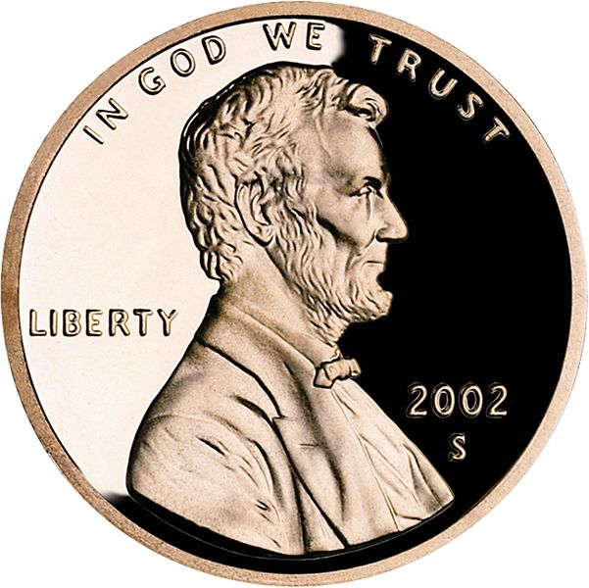
Probability?
What is the probability of a penny landing heads up when it is tossed?

Slide 7
Probability
The “Heads” side of the coin would be the only successful outcome
There are only two possible outcomes; “heads” or “tails”
Successful Outcomes → 1
Total Number of Outcomes → 2

Slide 8
Probability
So, there is a ½, or 1 out of 2 chance of flipping a coin and getting a “head”

Slide 9
What is the probability that a green candy will be pulled out on the first try?
Blue candy?
Red candy?

Slide 10
Theoretical Probability
Theoretical probability is based on mathematical reasoning.
Formula:

Slide 11
Experimental Probability
The experimental probability of an event is the ratio of actual outcomes to trials performed. Experimental probability is based on an actual experiment.
Formula:

Slide 12
Independent Practice
Independent Practice Explained
You now know what the objective for the day is, and how it works
Now is the time for you to get a chance to practice on your own…key words here are “ON YOUR OWN!!!”
A “Solution Station” is available for you to check your work…no pencils or pens when at the solution station
If you have questions, raise your hand and I’ll come and help

Slide 13
Exit Ticket
Step #1 – Look around the room
Step #2 – Count the number of students in the class
Step #3 – If I were to choose one student to be my favorite in the class, what is the probability that it would be a girl? Give your answer in ratio form and in lowest terms.

