Slide 1
Unit 8 - Probability
Day 2 – Compound probability

Slide 2
Warm Up
Billy is sitting in a plane at the airport. At the airport, there are 35 US Airways planes, 15 Delta planes, 5 Air France planes, and 5 British Airway planes.
What is the probability Billy is on a US Airways plane?
What is the probability Billy is NOT on a Delta plane?

Slide 3
Agenda
Warm up
Announcements
Compound Probability
Whiteboards
Independent Practice
Exit Ticket

Slide 4
Announcements
Unit 1 test will be next Wednesday

Slide 5
A Little Vocabulary…
Independent Events – involves two or more events in which the outcome of one event DOES NOT affect the outcome of any other events
EXAMPLE:
  Your grade in Math class and your grade in English class
  The final score of a hockey game played in Los Angeles, and the final score of a basketball game played in New York

Slide 6
A little more vocab…
Dependent Variables – involves two or more events in which the outcome of one event DOES affect the outcome of any other events
Examples:
  Drawing from the same deck of cards
  Selecting items from a container without replacement

Slide 7
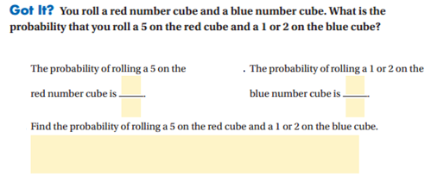
Independent

Slide 8
Find the probability
Independent Events
P(jack, factor of 12)
1
5
5
8
5
40
x
=
1
8
Slide 8

Slide 9
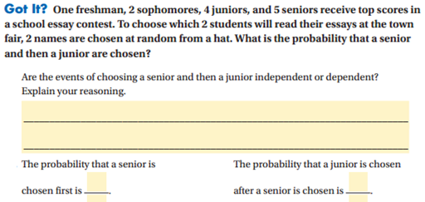
Dependent

Slide 10
Find the probability
Dependent Events
P(Q, S)
All the letters of the alphabet are in the bag 1 time
Do not replace the letter
1
26
1
25
1
650
x
=
Slide 10

Slide 11
Whiteboard Practice
Are these independent or dependent events?
Tossing two dice and getting a 6 on both of them.
2. You have a bag of marbles: 3 blue, 5 white, and 12 red. You choose one marble out of the bag, look at it then put it back. Then you choose another marble.

Slide 12
Whiteboards
Are these independent or dependent events?
3. You have a basket of socks. You need to find the probability of pulling out a black sock and its matching black sock without putting the first sock back.
4. You pick the letter Q from a bag containing all the letters of the alphabet. You do not put the Q back in the bag before you pick another tile.

Slide 13
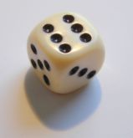
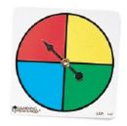
Whiteboard
A game uses a number cube and a spinner.
A player rolls a number cube. What is the P(odd #)?
The player spins the spinner. What is the P(red)?
What is the P(odd # and Red)?

Slide 14

Find the probability when rolling two dice
P(6, not 5)
1
6
5
6
5
36
x
=
Slide 14

Slide 15
Whiteboards
There are 3 yellow, 5 red, 4 blue and 8 green candies in a bag. Once a candy is removed it is not replaced. Find the probability:
P(two red candies)
P(two blue candies)
P(yellow candy followed by a blue candy)

Slide 16
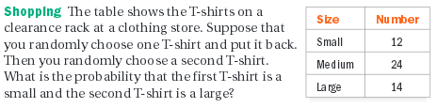
Whiteboards

Slide 17
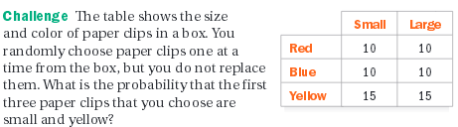
Whiteboards

Slide 18
Independent Practice
This is the time to really gauge how well you know this material
If you are having a hard time with this math now, you will most likely have a hard time on test day…let’s get that corrected right now
If you are struggling, ask questions

Slide 19
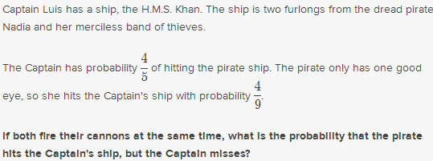
Exit Ticket

