Slide 1
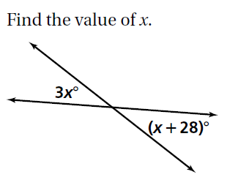
Do Now – 2nd Block

Slide 2
Do Now - Honors

Slide 3
Announcements
Congratulations on finishing Unit 1!!! You will get your graded test back tomorrow, along with your progress report.
Unit 2 Test Friday
Attendance Issues

Slide 4
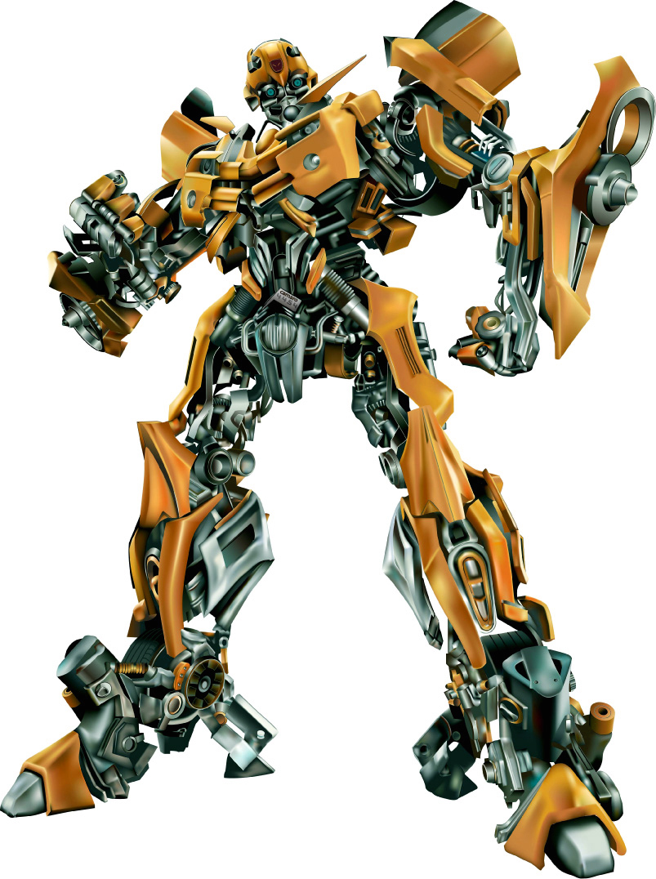
Unit 2 – Transformations!
BRING YOUR GRAPH PAPER FOR THIS UNIT!
2/13 – Translations & Reflections
2/14 – Rotations
2/15 – Dilations & Compositions
2/16 – Review Unit 2
2/17 – Unit 2 Test

Slide 5
Lesson 9-1 & 9-2: Translations and Reflections
Students will: identify isometries, create translation images of figures, create reflection images of figures.

Slide 6
Opening Video
http://www.youtube.com/watch?v=dVtz55mIuz4

Slide 7
Transformations
A transformation of a geometric figure is a change in the position, shape, or size of the figure.

Slide 8
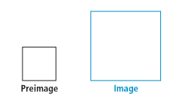
Transformations
The original figure is the preimage.
The resulting figure is the image.
An isometry is a transformation in which the preimage and image are congruent (same size/measurement).

Slide 9
Translation = Type of Transformation
$∆ABC → ∆A^{′}B^{′}C^{′}$
ABC is the preimage
A’B’C’ is the image
‘ = prime

Slide 10
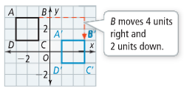
Translations
Each point moves the same number of units horizontally and vertically.
ABDC → A’B’D’C’
Our translation rule for this would be $(x,y)→(x+4,y−2)$
A, D, and C also move 4 units right and 2 units down!

Slide 11
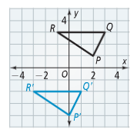
Translations
What is our preimage?
What is our image?
How many units does PQR move horizontally?
How many units does PQR move vertically?
What is our translation rule?

Slide 12
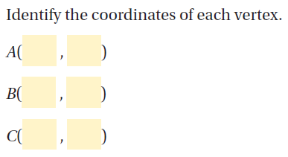
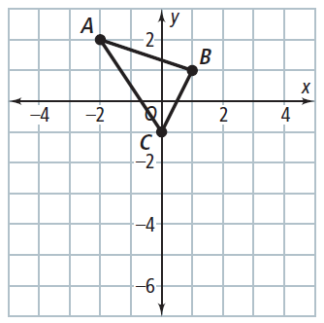

Slide 13
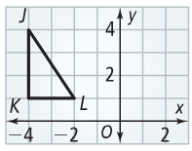
You try!
What are the images of vertices of ΔJKL for the translation $\left(x,y\right)→\left(x+3,y−1\right)$? Graph the image of ΔJKL.
Follow the steps!
1. Find the original points
of J, K, and L.
2. Apply the translation rule
to find J’, K’, and L’.
3. Plot the new image points!

Slide 14
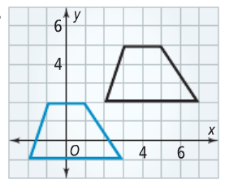
Write a rule from a translation

Slide 15
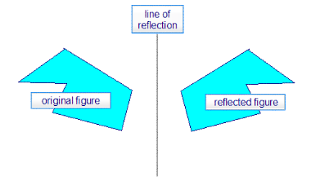
Reflection = Another Type of Translation
A reflection is a transformation that flips a figure across a line.

Slide 16
Reflections
When reflected across a line, the image and preimage are the same distance from the line of reflection.

Slide 17
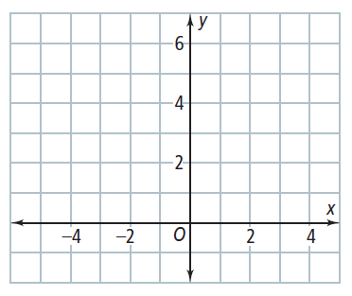
Reflections
If point P(3,4) is reflected across the line y = 1, what are the coordinates of it’s reflection image?

Slide 18
Reflections

Slide 19
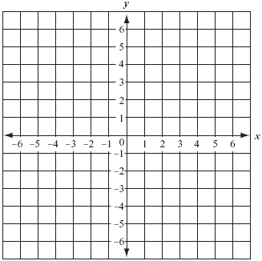
Reflections
Graph points P(4, 5), Q( 2, 1), and R(-2, 1). What is the image of ΔPQR reflected across the line y=-1?

Slide 20
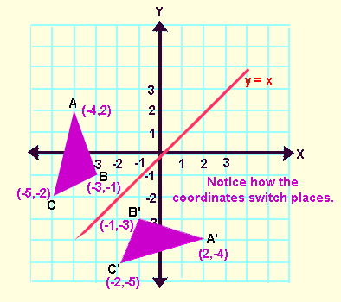
Honors - Reflections Across y=x
The reflection point for (x, y) across the line y=x is (y, x).
**Just switch your x and y coordinates!!

Slide 21
Practice!
Graph parallelogram ABCD with the following points: A(-3, 1), B(-5, 1), C(-5, 4), D(-3, 4). Draw the image of ABCD if it is reflected across the line y=x.

Slide 22
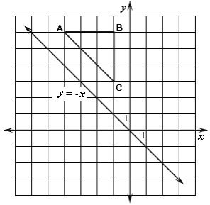
Honors - Reflection Across y=-x
The reflection point for (x, y) across y=-x is (-y, -x).
**Just switch your x and y coordinates and change the sign!!

Slide 23
Practice!
ΔJMK is found at points J(1,-4), M(5, -6), and K(2, -2). Graph both the preimage and image of ΔJMK if it is reflected across the line y=-x.

Slide 24
Independent Practice
Translations & Reflections Worksheet
Whatever you don’t finish is homework ☺

