Slide 1
Warm-up: Trig Review

Slide 2
Surface Area

Slide 3
Agenda
Warm-up
Homework
Announcements
Surface Area of Geometric Shapes
Trivia of the Day
Whiteboards
Surface Area and Volume Activity
Independent Practice
Exit Ticket

Slide 4
Homework
Equations of a circle
Volume
Density

Slide 5
Announcements
Tutoring today 3:30-4:30
Unit Quiz October 9, 2015
PSAT October 14, 2015
Midterm October 19 and 20,2015

Slide 6
Today’s Objective
Obj: I can determine the surface area of rectangular prisms, cylinders, and spheres.

Slide 7
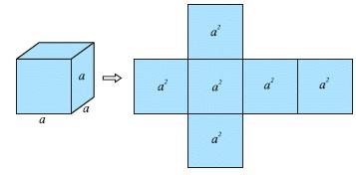
How many faces does the prism have? Do all rectangular prisms have the same number of faces? If a = 5, what is the surface area of the Cube?

Slide 8
Calculating Surface Area

Slide 9
Stop and Jot
Write at least two sentences explaining the difference between surface area and volume of a figure

Slide 10
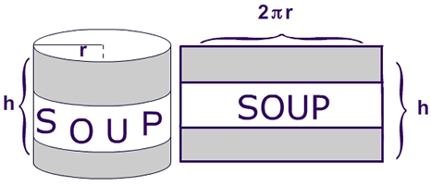
How many faces does the cylinder have? What is the formula for the area of the top and the bottom of the cylinder? Given the deconstructed cylinder, what do you think the formula for the surface of the side of the cylinder is?

Slide 11
Surface Area of a Cylinder

Slide 12
Stop and Jot
If you were told the volume of a cylinder, could you determine the surface area of the cylinder? Why or why not?

Slide 13
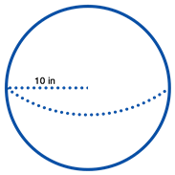
Surface Area of a Sphere
Surface area formula:
4πr²
What is the surface area of the sphere
to the right?

Slide 14
Trivia of the Day
What color was Coca-Cola originally?

Slide 15
Answer
Green

Slide 16
What is significant about the amazon logo?

Slide 17
Answer
The arrow pointing from A to Z is supposed to mean that Amazon deals with everything from A to Z

Slide 18
What is significant about the FedEx logo?

Slide 19
Answer
The shape created in the empty space between the letters E and X is an arrow. This is meant to show that FedEx will get your stuff there.

Slide 20
Whiteboards: Determine the surface area

Slide 21
Whiteboards: Determine the surface area
A sphere with a diameter of 20 yd.

Slide 22
Whiteboards: Determine the surface area and volume

Slide 23
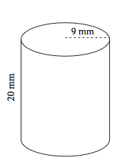
Whiteboards: Determine the volume and surface area

Slide 24
Whiteboards: Determine the surface area and volume

Slide 25
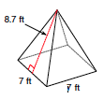
Whiteboards: Determine the surface area

Slide 26
Surface Area and Volume Activity

Slide 27
Independent Practice

Slide 28
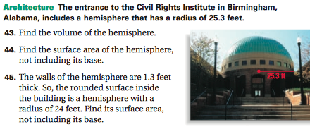
Exit Ticket

