Slide 1
Lesson 8-2: Special Right Triangles
Students will use the properties of 45-45-90 and 30-60-90 triangles.

Slide 2
Special Right Triangles

Slide 3
Steps for Special Right Triangles
Label the triangle with the formulas
Set the known side equal to the formula
Solve for s.
Plug s back in to unknown sides.
Simplify into simplest radical form

Slide 4
45-45-90 Triangles

Slide 5
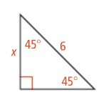
45-45-90 triangles
What is the value of x?

Slide 6
45-45-90 Triangles

Slide 7
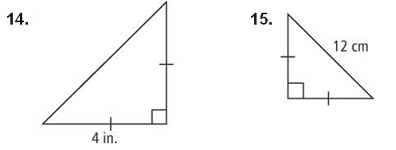
45-45-90 review
Find the missing side lengths. Leave answers in simplest radical form.

Slide 8
30-60-90 triangles

Slide 9
30-60-90 triangles
Find the values of the variables in simplest radical form.

Slide 10
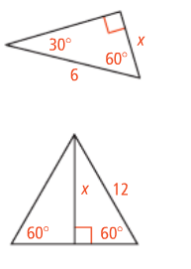
30-60-90 Triangles

