Slide 1
Domain & Range
February 20, 2015

Slide 2
Warm Up:
1. Determine whether each of the following is a function:
A. (2, 5) (4, 9) (5, 11) (-2, -3)
B. (1,2) (3, 2) (4, 2) (5, 2)
C. (2, 1) (2, 2) (2, 3) (2,4) (2, 5)

Slide 3
Obj:
I can Identify the domain and range of a function

Slide 5
Stop and Jot: Given your definition that domain is the input value into a function, how would you define RANGE of a function?

Slide 8
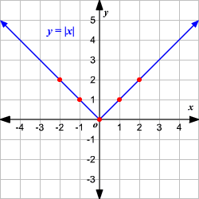
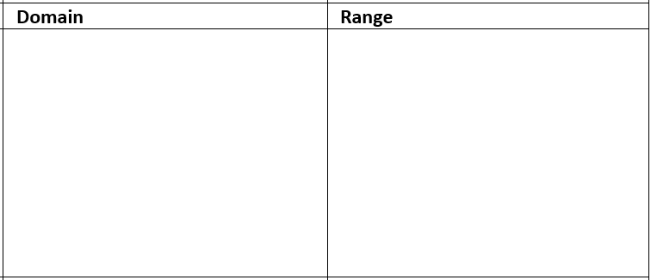

Slide 10
Test Prep!

Slide 11
Review
Group Quiz (functions)

Slide 12
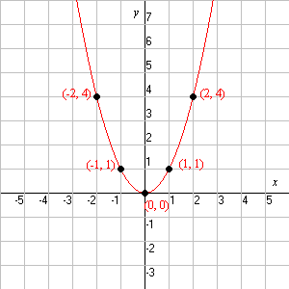
Exit Ticket
1. Determine the range of the domain provided:
f(x) = 3x + 1 domain: {-1, 0, 3, 5}
2. Determine the domain & range for the following function:

