Slide 1
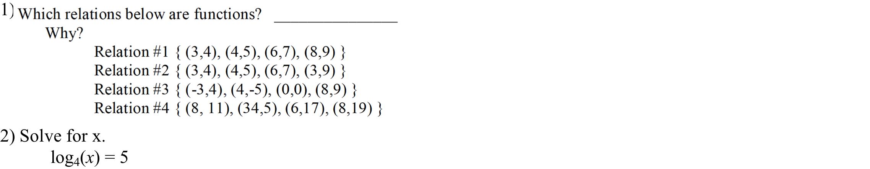
Warm-Up

Slide 2
Domain, Range &
Interval Notation

Slide 3
Vertical-Line Test
A set of points in the xy-plane is the graph of a function if and only if every vertical line intersects the graph in at most one point.

Slide 4
A function is a set of ordered pairs of numbers (x, y) such that no x –values are repeated.
What are the domain and range of a function?
The domain and range of a function are sets that describe those ordered pairs.

Slide 5
Domain: In a set of ordered pairs, (x, y), the domain is the set of all x-coordinates.
Range: In a set of ordered pairs, (x, y), the range is the set of all y-coordinates.

Slide 6
The set of ordered pairs may be a limited number of points.
Given the following set of ordered pairs, find the domain and range.
Ex:{(2,3),(-1,0),(2,-5),(0,-3)}
If a number occurs more than once, you do not need to list it more than one time.
Domain:
{2,-1,0}
Range:
{3,0,-5,-3}

Slide 7
The set of ordered pairs may be an infinite number of points, described by a graph.
Given the following graph, find the domain and range.

Slide 8
Domain:{all real numbers}
Range:{y:y≥0}

Slide 9
The set of ordered pairs may be an infinite number of points, described by an algebraic expression.
Given the following function, find the domain and range.
Example:
Domain:
{x: x≥5}
Range:
{y: y≥0}

Slide 10
Domain & Range
When stating the domain and range of a function, you have to look at the beginning and end of your function in order to properly label the domain and range.
Always write
domain: left < x < right
range: low < y < high
Inequality (Set) Notation
End Marking Notation
•
Use ≤
◦
Use <
∞
Do not write . Leave that side blank
If both ends of domain or range go to infinity, use
xєR or yєR

Slide 11
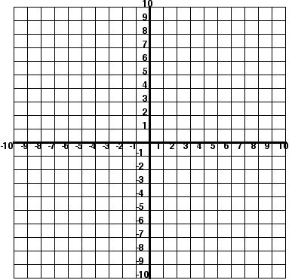
Inequality (set) Notation
Start with the domain- how far to the left does the function go?
    -5
What is the end marking? What inequality symbol will you use?
    Closed dot, so ≤
How far to the right does the domain go? What symbol will we use?
    3, closed dot so ≤
Now to the range- What is the lowest point my function reaches? What symbol?
    -3, ≤
What is the highest? Symbol?
    4, ≤
D:
R:
-5 ≤ x ≤ 3
-3 ≤ y ≤ 4

Slide 12
Domain & Range
Interval Notation
Always write
domain: left < x < right
range: low < y < high
End Marking Notation
•
Use [ or ]
◦
Use ( or )
∞ always gets parenthesis!!
∞
∞
Use (- or )

Slide 13
Interval Notation
Start with the domain- how far to the left does the function go?
    -5
What is the end marking? What interval symbol will you use?
    Closed dot, so [
How far to the right does the domain go? What symbol will we use?
    3, closed dot so ]
Now to the range- What is the lowest point my function reaches? What symbol?
    -3, [
What is the highest? Symbol?
    4, ]
D:
R:
[-5, 3]
[-3, 4]

Slide 14
Interval Notation
Start with the domain- how far to the left does the function go?
    -8
What is the end marking? What inequality symbol will you use?
    Closed dot, so [
How far to the right does the domain go? What symbol will we use?
    Infinity, )
Now to the range- What is the lowest point my function reaches? What symbol?
    Negative infinity, (
What is the highest? Symbol?
    4, ]
D:
R:
[-8, ∞)
(- ∞ , 4]

Slide 15
Interval
D:
R:
Inequality
D:
R:

Slide 16
Interval
D:
R:
Inequality
D:
R:

Slide 17
Interval
D:
R:
Inequality
D:
R:

Slide 18
Interval
D:
R:
Inequality
D:
R:

