Slide 1
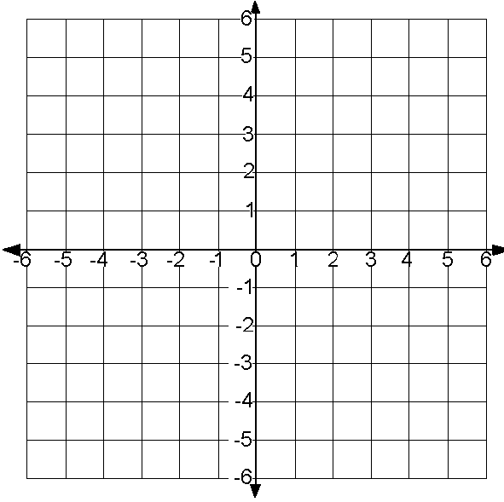
A
A
M
w
x
T
H
z
y
C
B
Enlarge the figure by a scale
factor of 2 from the origin.
Draw the dilated image of triangle ABC from the origin with a factor of ½
Enlarge trapezoid MATH by a factor of 3 from the origin.
A
w
x
U
z
y
C
B
V
L
Enlarge the figure by a scale
factor of 2 from the center of
dilation at the origin.
Draw the dilated image of triangle ABC with a center of dilation at the origin and a scale factor of ½
Enlarge LUV by a factor of 2
From the origin.

