Slide 1
Do Now!
Find the value of x.

Slide 2
Lesson 9-5: Dilations
Objective: Students will recognize and create dilations in the coordinate plane.

Slide 3
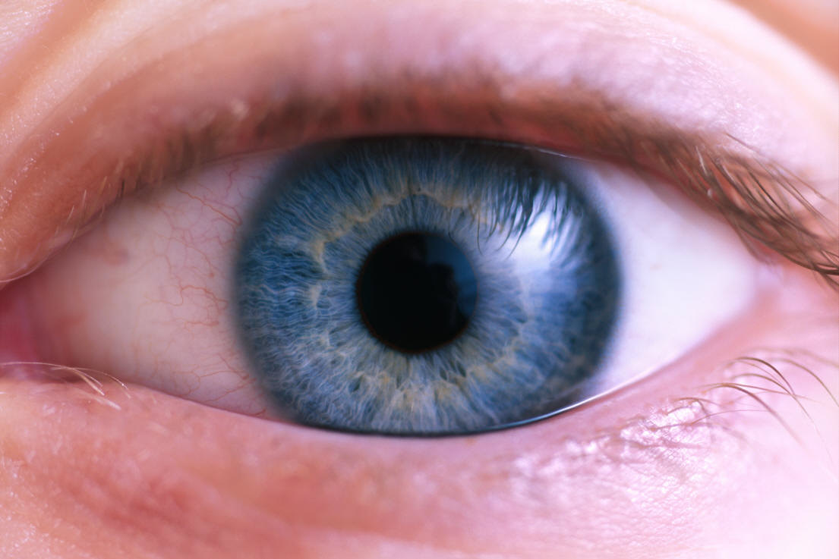
Where have you heard the word Dilate?

Slide 4
Reflections, rotations, and transformations all change the location of a point or figure
Dilations are different, they change the SIZE of the figure, either making it LARGER or smaller.
Are Dilations an isometry???
Figure A
Figure A’
Figure A’

Slide 5
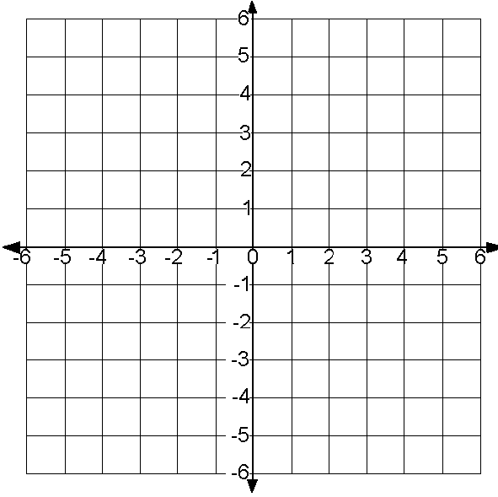
Enlarge the triangle by a factor of 2 from a center of dilation (projection point) at the origin.
Steps to Dilating:
Write down the given points.
Multiply each x and y coordinate by the factor of dilation.
Graph your new points.

Slide 6
Draw the dilated image of parallelogram MNOP from the origin with a factor of ½.
Steps to Dilating:
Write down the given points.
Multiply each x and y coordinate by the factor of dilation.
Graph your new points.

Slide 7
Honors: Compositions of Transformations

Slide 8
Practice!!
Now that we’ve done all three types of translations, let’s practice – Trashketball!
Formula Sheet

Slide 9
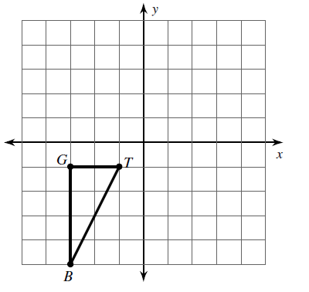
Translations
Write the translation rule for triangle GTB if it is translated 5 units right and 1 unit up.
Graph the image of triangle GTB

Slide 10
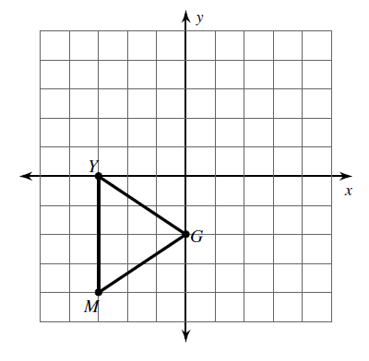
Translations
Write the translation rule for triangle YGM if it is translated 2 units up.
Graph the image of triangle TGM.

Slide 11
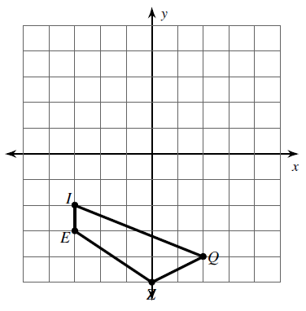
Reflections
1. Draw the image of figure EIQX if it is reflected across the y-axis.

Slide 12
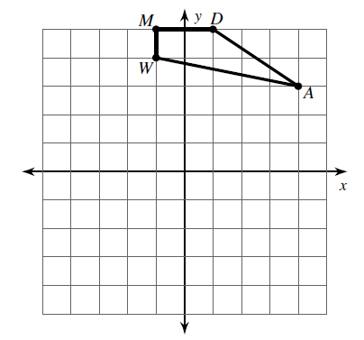
Reflections
Graph the image of figure MDAW if it is reflected across the x-axis.

Slide 13
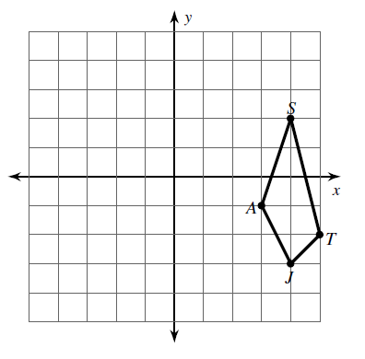

Reflections
Graph the image of figure ASTJ if it is reflected across the line $y=x$.

Slide 14
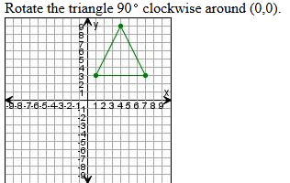
Rotations

Slide 15
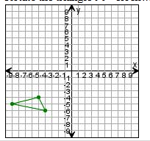
Rotations
Rotate the triangle 180 degrees.

Slide 16
Dilations
A
What are the coordinates of ABC after it is dilated by a factor of ½ ?
C
B

Slide 17
Dilations
What are the coordinates of MATH after being dilated by a factor of 2?
A
M
T
H

Slide 18
Homework
Transformations Review Worksheet

