Slide 1
Lesson 5-3: Bisectors in Triangles
Students will construct the incenter and circumcenter of a triangle.

Slide 2
VOCABULARY
When three or more lines intersect at one point, they are concurrent.
The point at which the three lines intersect is called the point of concurrency.
Circumcenter: where the perpendicular bisectors of each side of the triangle are concurrent
Incenter: where the angle bisectors of a triangle are concurrent.

Slide 4
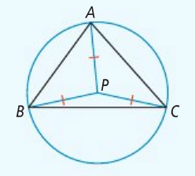
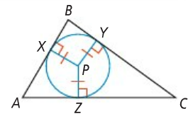
Where do the names come from?
Circumcenter
Incenter

Slide 5
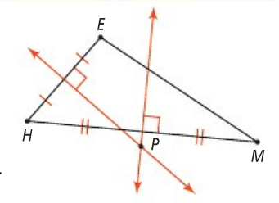
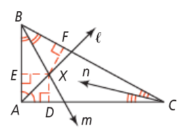
Identify the following concurrent points as circumcenters or incenters:

Slide 6
Lesson 5-4: Medians
Students will identify the median and centroid of a triangle.

Slide 7
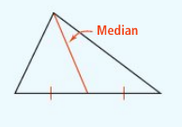
A median of a triangle is a segment whose endpoints are a vertex and the midpoint of the opposite side.
A triangle’s three medians are always congruent!

Slide 8
Is XY a median, angle bisector, or perpendicular bisector? How do you know?

Slide 9
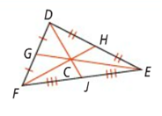
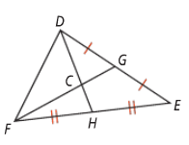

Slide 10
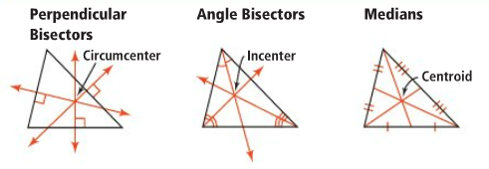

Slide 11
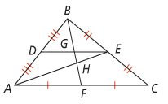
Look at the diagram above. Name the:
Midsegment:
Median:
Centroid:

Slide 12
Triangle Rule!
The largest angle is across from the largest side

Slide 13
