Slide 1
CPCTC & HL

Slide 2
CPCTC

Slide 3
CPCTC

Slide 6
Lesson 4-6: Congruence in Right Triangles
Students will prove two right triangles are congruent using the Hypotenuse-Leg Theorem.

Slide 7
Right Triangles

Slide 8
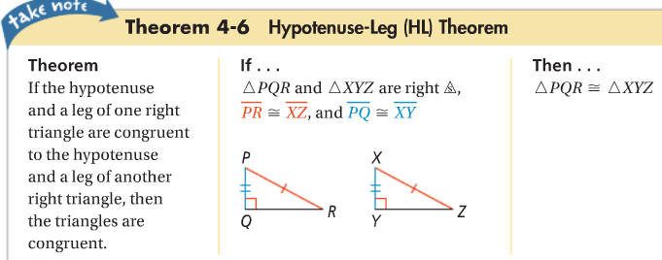
Hypotenuse-Leg (HL) Theorem

Slide 9
BUT….

Slide 10
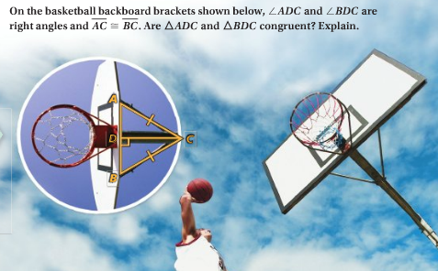

Slide 12
Example Problem
For what values of x and y would the triangles be congruent by HL?
15
X+10
2x + 2y
4x – 3y

Slide 13
Practice
State the postulate or theorem you would use to prove each pair of triangles congruent. If the triangles cannot be proven congruent, write not enough information.

