Slide 1
Lesson 5-2: Perpendicular & Angle Bisectors
Students will use the properties of perpendicular bisectors and angle bisectors.

Slide 2
Let’s Review!
What is a perpendicular bisector?

Slide 3
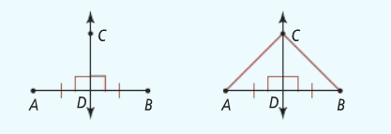
Let’s Review!
What is a perpendicular bisector?
A perpendicular bisector is a line or segment that:
Is perpendicular to a segment/line
Splits that same segment/line into two equal parts.

Slide 4
Connect the points to make a triangle.

Slide 5
New Vocabulary
A point is equidistant from two objects if it is the same distance from the objects.
Point C is equidistant from points A and B.

Slide 10
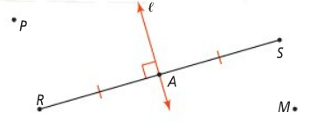

Slide 11
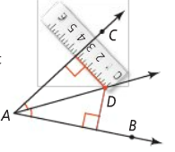

Slide 14
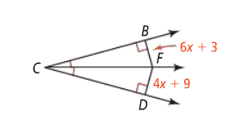

Slide 16
