Slide 1
Lesson 5-1: Midsegments of Triangles
Students will use properties of triangle midsegments to solve problems.

Slide 2
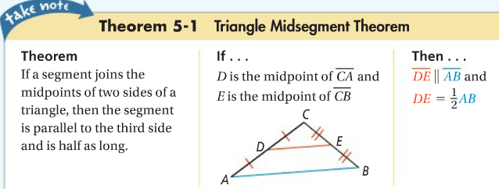
Midsegment of a Triangle
A midsegment of a triangle is a segment connecting the midpoints of two sides of the triangle.

Slide 3
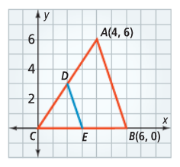
How does the Triangle Midsegment Theorem work?

Slide 5
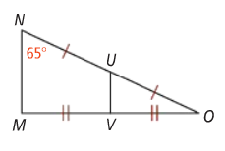
Which two lines are parallel in this triangle? How do you know?
If UV = 10 and NM = 4x, what is the value of x?
If UV = 2x and NM = 40, what is the value of x?

Slide 6
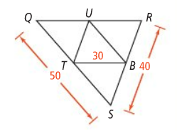

Slide 7
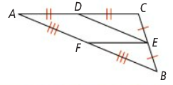
You try!

Slide 8
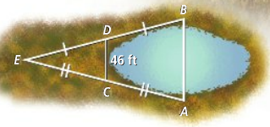

Slide 9
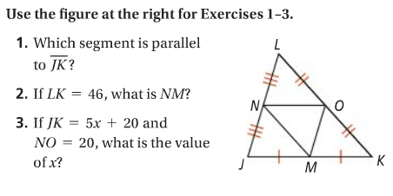
Check your understanding!

