Slide 1
Lesson 4-5 Isosceles and Equilateral Triangles
Students will use and apply properties of isosceles and equilateral triangles

Slide 2
Isosceles Triangles
An isosceles triangle is made up of two congruent legs and a base.

Slide 5
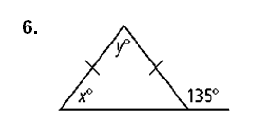
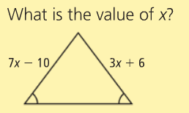

Slide 7
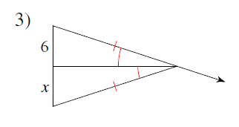
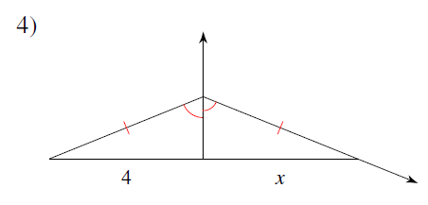
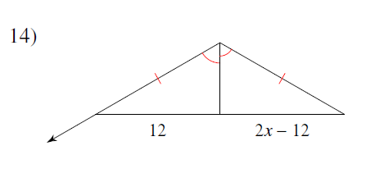
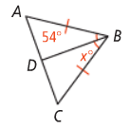
15)

Slide 8
A corollary is a theorem that can be proved easily using another theorem.
You can use them in proofs!

Slide 9
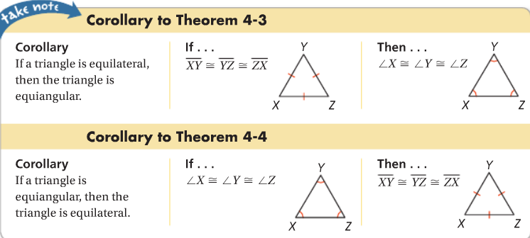
Equilateral Triangles – all sides and angles are congruent!

Slide 10
Equilateral Triangles – all sides and angles are congruent!

Slide 11
The triangle below is an equilateral triangle. What is the measurement of one of the angles?

Slide 13
Battle of the Boards
ALL team members work out the solutions on their own paper (to be turned in!!)
ONE PERSON writes the answer on the board and holds it up when asked.
Tickets given to teams with the correct answer.
Write your team’s number on the back of the ticket
After the game, I will draw one ticket → that whole group will get homework passes ☺

Slide 14
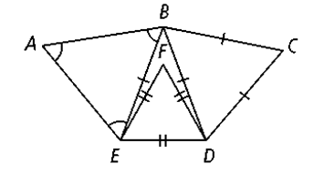
Question 1
Complete the statement. Explain WHY it is true.

Slide 15
Question 2
Complete the statement. Explain WHY it is true.

Slide 16
Question 3
Complete the statement. Explain WHY it is true.

Slide 17
Question 4
Complete the statement. Explain WHY it is true.

Slide 18
Question 15
The wall at the front entrance to the Rock and Roll Hall of Fame and Museum in Cleveland, Ohio, is an isosceles triangle. The triangle has a vertex angle of 102. What is the measure of the base angles?

Slide 19
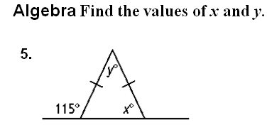
Question 5

Slide 20
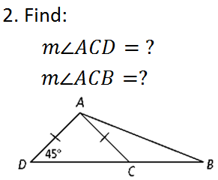
Question 6

Slide 21
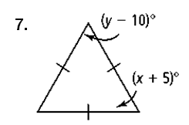
Question 7
Find the values of x and y.

Slide 22
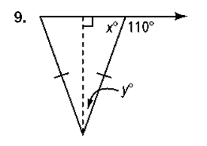
Question 9
Find the values of x and y.

Slide 23
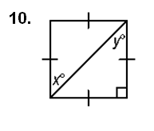
Question 10
Find the values of x and y.

Slide 24
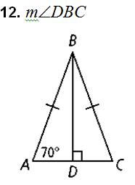
Question 12
Find the measure of the indicated angle.

Slide 25
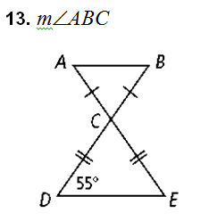
Question 13
Find the measure of the indicated angle.

Slide 26
Question 14 CHALLENGE – double tickets!!!
Equilateral ΔABC and isosceles ΔDBC share side BC. If m$∠BDC=34$ and BD = BC, what is the measure of $∠ABD?$ (HINT: it may help to draw the figure!)

Slide 27
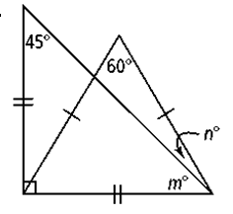
Question 16
Find the values of m and n.

Slide 28
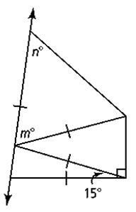
Question 17
Find the values of m and n.

