Slide 1
Do Now (& turn in HW)
Read the article on your desk. Then answer the questions below. Do NOT write on the article.
Why is his discovery of pi so important?
Why is Archimedes still remembered and considered important?
Who was Archimedes influence by in school?

Slide 2
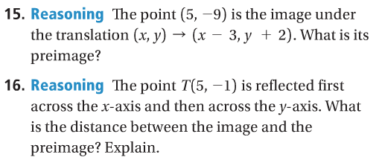
Honors - Push your thinking…

Slide 3
What are we doing today? – 2nd
Learn reflections over y = x
Complete study guide
Start Unit 2 Project

Slide 4
What are we doing today? – 3rd & 4th
Lesson on Composition of Transformations
Complete unit 2 study guide
Start unit 2 project

Slide 5
2nd Block – Reflections across y=x
Students will reflect images across y=x.

Slide 6
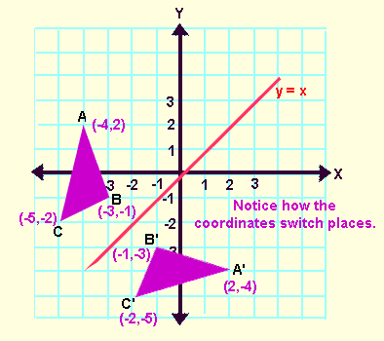
Reflections Across y=x
The reflection rule for (x, y) across the line y=x is (y, x).
**Just switch your x and y coordinates!!

Slide 7
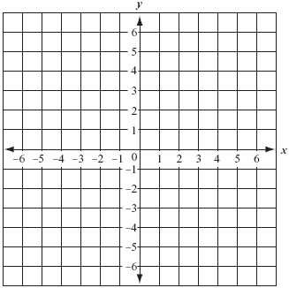
Practice!
Graph parallelogram ABCD with the following points: A(-3, 1), B(-5, 1), C(-5, 4), D(-3, 4). Draw the image of ABCD if it is reflected across the line y=x.

Slide 8
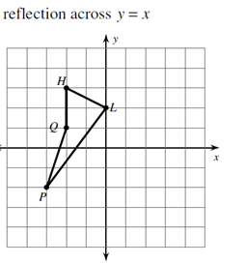

Slide 9
HONORS - Lesson 9-6: Compositions of Transformations
Students will perform compositions of transformations.

Slide 10
A composition of transformations is a combination of two or more transformations.
In a composition, you perform each transformation on the image of the preceding transformation.

Slide 11
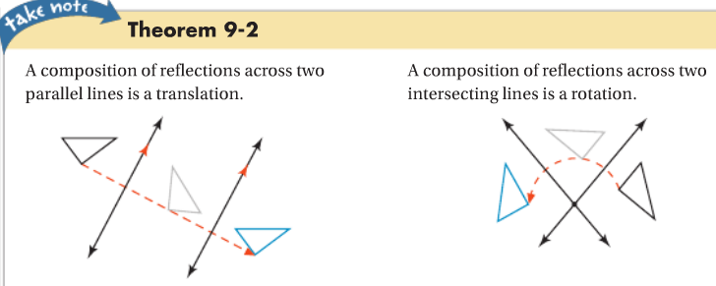

Slide 12
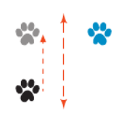
A glide reflection is the composition of a translation and a reflection across a line to the direction of translation.

Slide 13
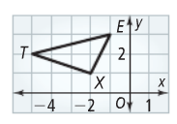

Slide 15
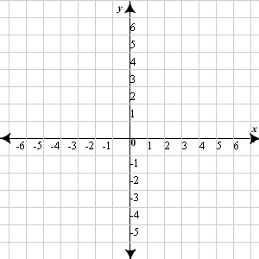
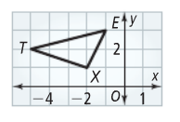

Slide 16
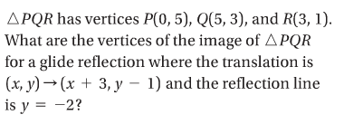

Slide 17
Independent Practice
Workbook Practice 9-6 (#3-6)
Study Guide
Project

