Slide 1
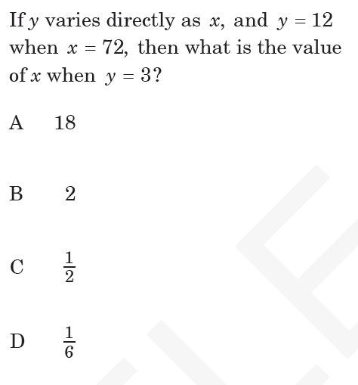
Warm Up: EOC Challenge!

Slide 2
8.2: Exponential Functions Exponential Growth & Decay
We can determine types of functions from a t-chart
And model exponential growth and decay.

Slide 3
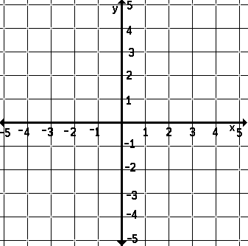
Exponential Functions
An exponential function is a function in the form of
$y=a^{x}$
where a is any number that’s not 0
Example: $y=2^{x}$
x y
a^{x}
2^{x}

Slide 4
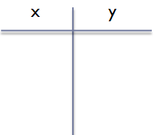

What is the difference between an exponential function & a linear function?
Linear Function: $y=mx+b$
Exponential Function: $y=a^{x}$
a^{x}
Example: $y=2x+5$
Example: $y=3^{x}$
3^{x}

Slide 5
What is the difference between an exponential function & a linear function?
Linear
Exponential
Straight line
As x changes by 1, y changes by adding or subtracting the same number each time
Curved line
As x changes by 1, y changes by multiplying or dividing by the same number each time

Slide 6
Let’s look at another example…
By looking at the t-chart below, can you tell if the function is linear or exponential?
X | 1 | 2 | 3 | 4
Y | 5 | 7 | 9 | 11

Slide 7
Let’s look at another example…
By looking at the t-chart below, can you tell if the function is linear or exponential?
X | -1 | 0 | 1 | 2
Y | 32 | 16 | 8 | 4

Slide 8
Let’s look at another example…
By looking at the t-chart below, can you tell if the function is linear or exponential?
X | 3 | 5 | 7 | 9
Y | 10 | 5 | 0 | -5

Slide 9
Let’s look at another example…
By looking at the t-chart below, can you tell if the function is linear or exponential?
X | 0 | 1 | 2 | 3
Y | 1 | 3 | 9 | 12

Slide 10
Exponential Growth & Decay
Exponential growth: when a quantity increases at the same rate over each time period
$$A=P{\left(1+r\right)}^{t}$$
Exponential decay: when a quantity decreases at the same rate over each time period
$$A=P{\left(1−r\right)}^{t}$$
A = final amount
P = principal (initial amount)
r = rate (must be in decimal form!!)
t = time (in years)
^{t}
^{t}

Slide 11
Key Words
Exponential Growth
Increases
Appreciates
Exponential Decay
Decreases
Depreciates

Slide 12
Example
In 1971 there were 294,105 females participating in high school sports in America. Since then, that number has increased an average of 8.5% each year. How many participated in 2006?

Slide 13
Example
The original price of a tractor was $45,000. The value of the tractor decreases at a steady rate of 12% each year. What is the value of the tractor after 5 years?

Slide 14
Compound Interest
A = final amount
P = principal (initial amount)
r = rate (must be in decimal form!!)
t = time (in years)
n = number of times the interest is compounded each year
For compound interest, we use a different formula:
$$A=P{\left(1+\frac{r}{n}\right)}^{nt}$$
Use this formula when the word problem says that the interest is compounded.
)^{nt}

Slide 15
Example
Determine the amount of an investment if $500 is invested at an interest rate of 4.35% compounded quarterly for 12 years.

Slide 16
Example
The Johnson family bought a house for $110,000 in 2000. If its value appreciates at an average rate of 6% per year, what will the value be in 2005?

Slide 17
Independent Practice
What you do not finish is HOMEWORK, in addition to your weekly homework

Slide 18
Released Exam Practice
Complete the following problems with a partner
1, 2, 3, 4, 5, 18

Slide 19
Exit Ticket

