Slide 1
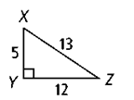
Review from yesterday…
Write the ratios for sine, cosine, and tangent for angle X.

Slide 2
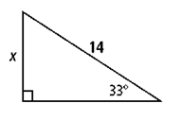
Review from yesterday…
Find the value of x.

Slide 3
Lesson 8-4: Angles of Elevation & Depression
Students will use angles of depression and elevation to solve problems.

Slide 4
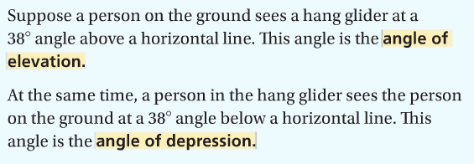
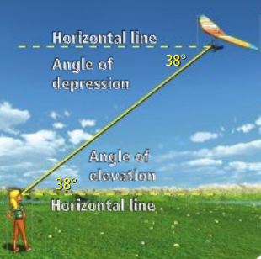
Vocabulary

Slide 5
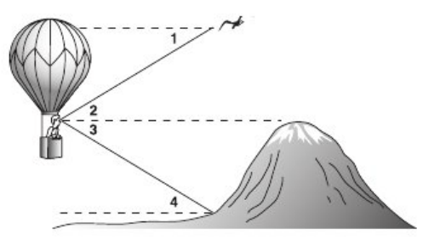
Identifying Angles of Elevation/Depression
Label each angle as an angle of elevation or an angle of depression.

Slide 10
