Slide 1
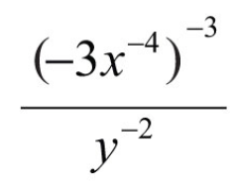
Warm Up
Simplify:
The names of 9 boys and 11 girls from a driver’s ed. Class are put into a hat to pick who drives first. What is the probability that the first two names chosen will BOTH be boys? (Hint: Determine type of event first!)

Slide 2
Warm Up (H)
Simplify:
In an election, candidate A received 35% of the votes, candidate B received 22% of the votes, and candidate C received 43% of the votes. If you randomly selected a person from all who voted, what is the probability that the person voted for either candidate A or candidate B?

Slide 3
Check In
Have you ever done a random act of kindness? If so, what was it?
Reminder: Test tomorrow on Experimental & Theoretical Probability, Compound Events, and Frequency Tables!!

Slide 4
Agenda
Warm Up & Check In
Returning Midterms
Dividing & Multiplying Polynomials
Partner Work
Gallery Walk Review: Unit 5
Exit Ticket

Slide 5
Midterms & Grades
B1 Average: 64%
B2 Average: 70%
B4 Average: 88%
Your Quarter 1 grade is written in red in the TOP RIGHT corner of your midterm answer sheet

Slide 6
6.3: Objective
We can multiply and divide polynomials
EXAMPLES
Multiplying
Dividing
12x(x² – 3x + 2)
z(z² + 4zx) - 5
(y + 4)(y – 3)
(2b + 4)(b² – 2b + 4)

Slide 7
Dividing Monomials
Extending our exponent rules…

Slide 8
Dividing Monomials
Simplify.

Slide 9
Dividing Polynomials (H)
Dividing a trinomial by a monomial

Slide 10
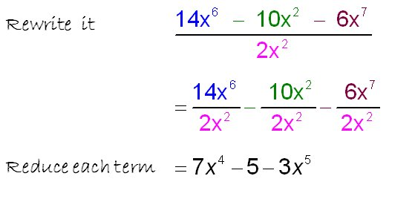
Dividing Polynomials (H)
Dividing a trinomial by a monomial

Slide 11
Multiplying Polynomials
Multiplying a MONOMIAL by a polynomial
STEPS

Slide 12
Multiplying Polynomials
Multiplying a MONOMIAL by a polynomial
Example #2
STEPS

Slide 13
Multiplying Polynomials
Multiplying a BINOMIAL by a BInomial
Box Method
Stacking
F.O.I.L.

Slide 14
Multiplying Polynomials
Multiplying a BINOMIAL by a TRInomial
Box Method
Stacking
Distribution
F.O.I.L.
You can only use F.O.I.L when multiplying two binomials

Slide 15
Pushing Our Thinking
How can we rewrite this? Then solve…

Slide 16
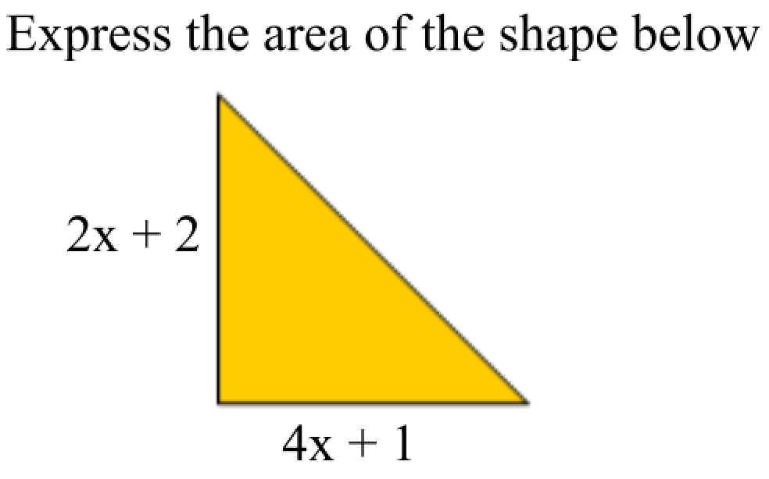
Pushing Our Thinking
How can we set this up? Then solve…
EQUATION:

Slide 17
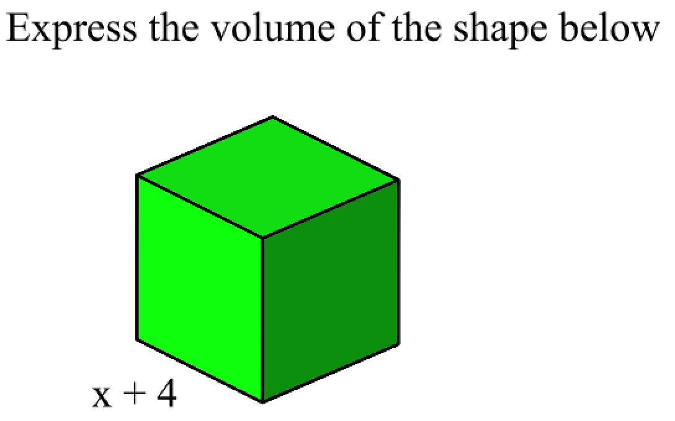
Pushing Our Thinking
How can we set this up? Then solve…
EQUATION:

Slide 18
Partner Work
Practice

Slide 19
Gallery Walk: Review Unit 5
There are 6 problems posted around the room that have been solved INCORRECTLY.
Identify at least one error in EACH problem
On a post-it, write where the person went wrong and EXPLAIN WHY.
Place post-it on poster and repeat for the other problems.
**If you get stuck, use your peers’ post-its for guidance**
Reminder: There is more than one error per problem!

Slide 20
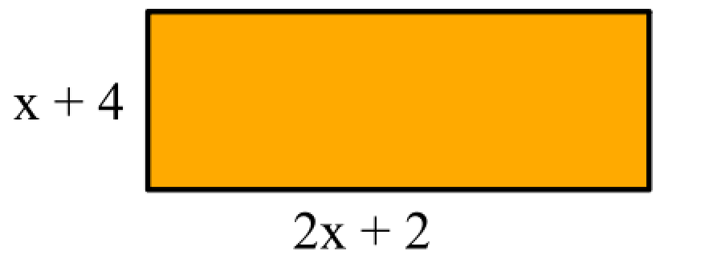
Exit Ticket
Simplify.
Simplify.
Express the area of the shape below in simplest form.

Slide 21
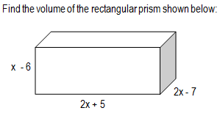
Exit Ticket (H)
Simplify. 2t²(3t³ + 4t – 7) + 2t
Simplify.
Express the volume of the shape below in simplest form.

