Slide 1
Write on board
Objective:
I can solve problems involving density, mass, and volume
Agenda:
Warm Up
Density
Table Work
Unit 4.1-4.2 Test
Exit Ticket: Survey

Slide 2
Warm Up
What is the distance between A(-2, 9) and B(5, -1/5)?
If the line segment AB (from problem 1) is the diameter of Circle X, then what is the center of Circle X?
Write the equation for Circle X.

Slide 3
Announcements
PSAT October 14, 2015
Unit 4 test (part two) October 16, 2015
Midterm
1st Block October 19, 2015
2nd Block October 20th, 2015

Slide 4
Agenda
Homework collection
Population Density
Midterm Review
Unit four test (part one)

Slide 5
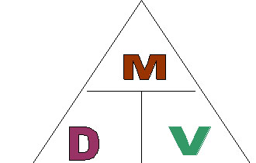
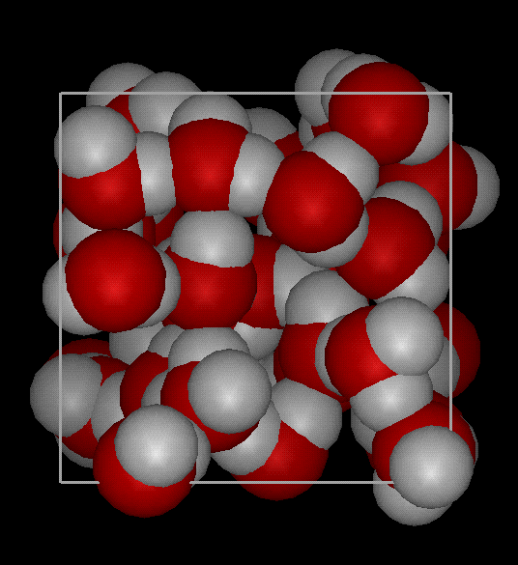
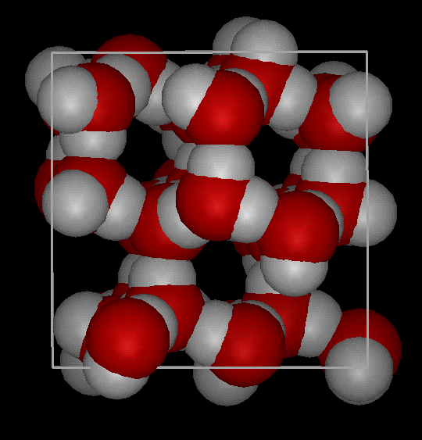
Review
Density =
some mass
PER
unit of space
M = D x V V = M / D D = M / V
A King Size waterbed has the following dimensions 72 in. x 84 in. x 9.5in. If the density of water is 0.036 lbs/in³, then what is the weight of the water inside the bed when full?

Slide 6
Population Density
Try to come up with a definition of population density with your table
Population density – population of living organisms (some mass) PER unit of area
Why PER unit of “area” instead of “volume”?
So if D = M/A, then what do we think the population density of our classroom would be if our room is 200ft² and we have ____ number of people?
What does this really mean?
That each person occupies ______ft²

Slide 7
Real World Application
Number of living organisms
Population density = the area they occupy
Which city do you think has a higher population density, Manhattan (NYC) or Charlotte? Why?
If the population of Charlotte is 792,862 and Charlotte is 297.7 mi², then what is Charlotte’s population density?
If the population of Manhattan is 1.626 million and Manhattan is 33.77mi², then what is Manhattan’s population density?
Knowing this, would you prefer to live in Charlotte or Manhattan? Explain your choice.

Slide 8
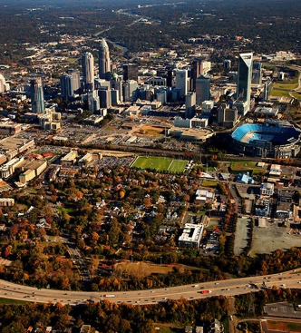
Population Density
Charlotte
Manhattan

Slide 9
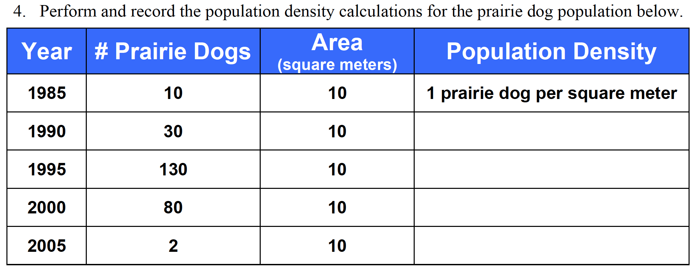
Population Density
Wichita, Kansas has 344,234 people within 165.9 square miles. What is Wichita’s population density?
2.

Slide 10
Desk work

Slide 11
Table Work
The pre-image A(1, 2) B(1, 4) and C(4, 2) is rotated 180 clockwise, what are the values of the image.
2.
3.
4.
What is the mass of a 350 cm³ sample of pure silicon with a density of 2.336 g/cm³?

Slide 12
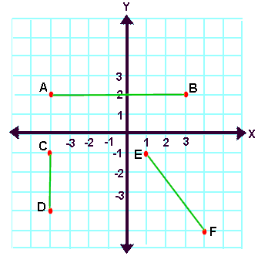
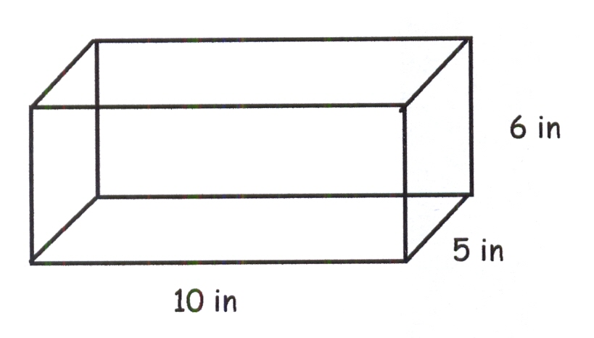
Desk Work
Find the midpoint and
distance of the following
image.
What is the equation of a circle with center (-1,-2) and a radius of ?
The density of silver is 10.49 g/cm³. If a sample of pure silver has a volume of 12.992 cm³, what is the mass?
Find the volume and surface area of
the rectangular prism.

Slide 13
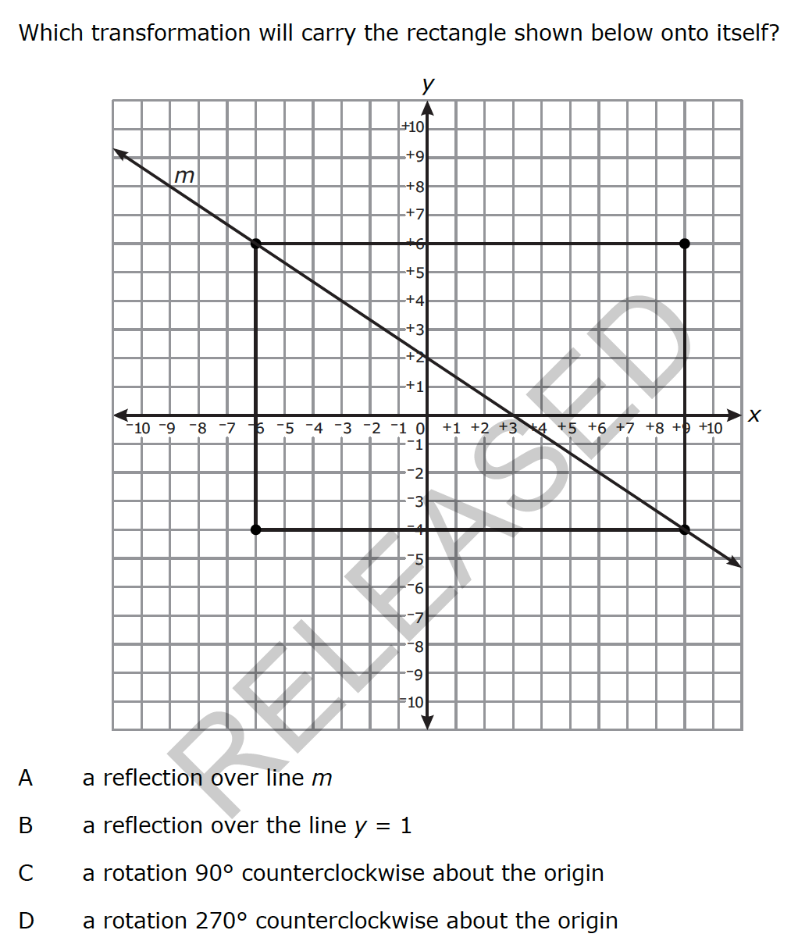
Exit Ticket

Slide 14
Test: Good Luck! 85% mastery!!
Believe you can and you’re halfway there!

